Slide 1
Nerdy Nets – GPT2
Rashi Dhar, Soma A. Hota, Matthew McAvoy

Slide 2
Model Overview
Query Algorithm
Transformer/LSTM algorithm
GPT-2 algorithm
Model loss
GPT-2 loss
Original paragraph (400 words)
Generated paragraph (400 words)
Generated summary (100 words)

Slide 3
Metadata
TLDR reddit dataset – 10GB (3,084,410 lines)
Cleaned data – 3GB
Vocab_size – 717,515
longest paragraph: 1015
longest summary: 397

Slide 4
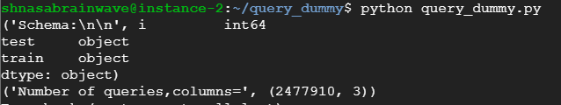
Query Algorithm
Outputs the relevance of keywords to some specific documents using TD-IDF (Term Frequency - Inverse Document Frequency)
Preprocessed data is further preprocessed to remove the
stop-words and punctuations.
II. Extract the JSON schema (train and test)
III. Create vocabulary and Word Counts for IDF
Compute IDF values.
Extracting keywords
Sort the values in the vector while preserving the column index of the extracted keyword.
Return the sorted values.

Slide 5
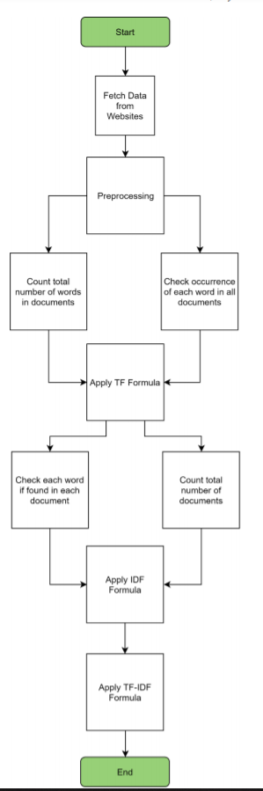
Query Algorithm design flow

Slide 6
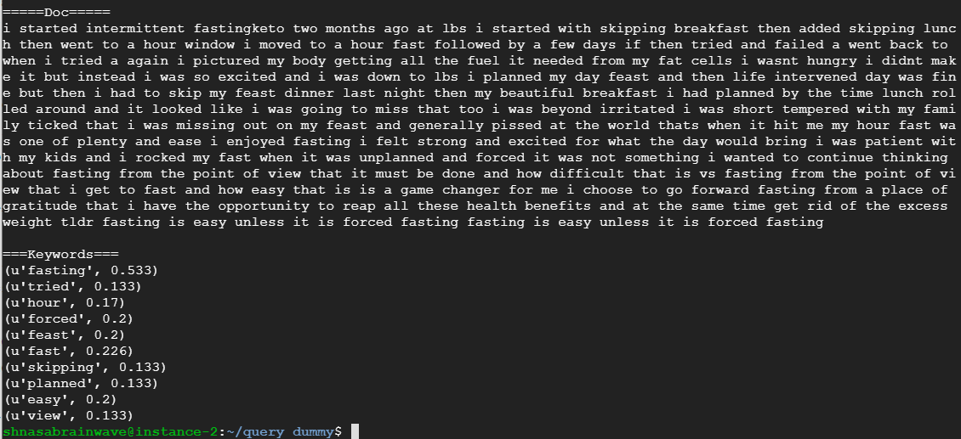
Query Result

Slide 7
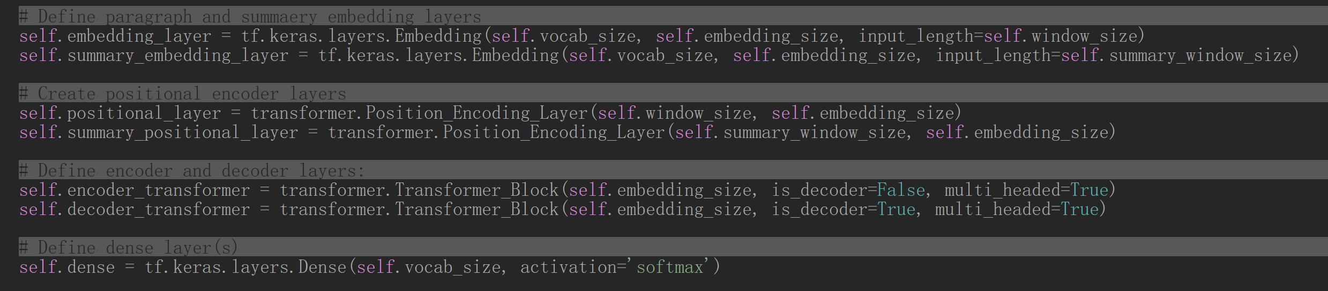
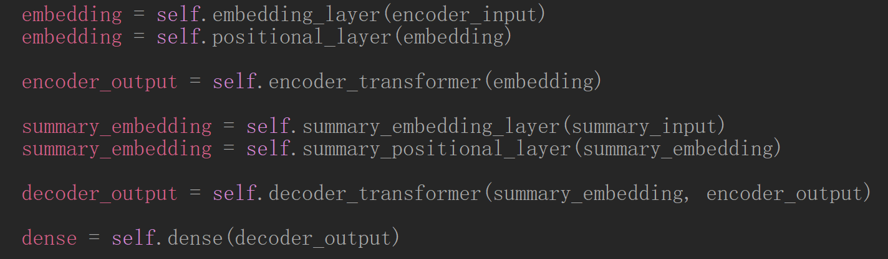
Transformer Algorithm
sizes
Encoder size = decoder size = 15
Window size = summary window size = 100
Vocab size = 717515

Slide 8
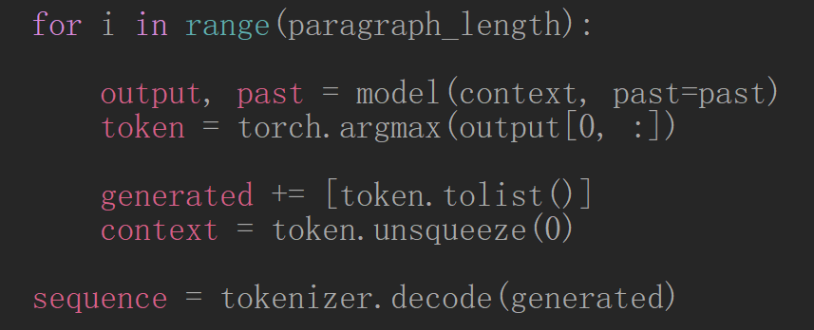
GPT-2 Algorithm
OpenAI GPT-2 model 124M parameter model (smallest) trained on 40GB of text data

Slide 9
GPT-2 Results
Original Paragraph
Generated Paragraph
dinoflagellates certainly can be toxic indeed if you consume seafood contaminated with harmful dinoflagellates the seafood especially shellfish having consumed the dinoflagellates as food themselves it can be fatal many dinos produce neurotoxins known as dinotoxins and the us military has even developed one of them saxitoxin for use as a biological weapon
as to whether these bioluminescent variants produce these toxins in sufficient quantities themselves i dont know sorry though i suspect even if they did the plankton itself wouldnt carry the bioload needed to harm a human it would need to first be concentrated and accumulated to a degree far beyond normal contact first
tldr though dinoflagellates can be incredibly toxic even if these ones are splashin and rollin around in em isnt going to do you any harm unless you sieve em all up and drank zooplankton smoothie after zooplankton smoothie bottoms up
and then you can just go to the bathroom and get a glass of water.
I'm not saying that you should drink zooplankton smoothies, but I'm saying that you should drink zooplankton smoothies.
I'm not saying that you should drink zooplankton smoothies, but I'm saying that you should drink zooplankton smoothies.
I'm not saying that you should drink zooplankton smoothies, but I'm saying that you should drink zooplankton smoothies.
I'm not saying that you should drink zooplankton smoothies, but I'm saying that you should drink zooplankton smoothies.
I'm not saying that you should drink zooplankton smoothies, but I'm saying that you should drink zooplankton smoothies.
Original Summary
lm_loss: 16.57
– argmax is limited
though dinoflagellates can be incredibly toxic even if these ones are splashin and rollin around in em isnt going to do you any harm unless you sieve em all up and drank zooplankton smoothie after zooplankton smoothie bottoms up

Slide 10
Transformer Results
Original Paragraph
Generated Summary
my best friend since high school is still my friend but i no longer consider him best now i call him my good friend even though ive known him longer then some of my best friends now this is because when he got caught smoking weed by his parents he threw me and my other friend j under the bus telling his parents it was ours and we introduced him to it then when he got caught again several months later he did the same thing he got caught a third time and guess what he did the same damn thing he tried lying about it to but im not dumb and i called him on his bullshit he got super dramatic and sort of teared up on why he did it but i told him bluntly that i had been put in the same situation and didnt rat my friends out plus his fiance is a total bitch when they were first engage he asked me to be a part of his wedding and i gladly said yes this was before he got caught smoking for a third time when he got caught by the way i was at my college living there about 2 hours away when this happened he told them it was me his parents and his fiance then pushed him to exclude me from the wedding…
friend got andor general failing me under the shoes multiple times asked me to be in his wedding then a few months later rent me out of it STOP liberal ruin chaos
Original Summary
Train perplexity: 3.28
Test perplexity: 4.42
accuracy: 75.6
friend got caught smoking threw me under the bus multiple times asked me to be in his wedding then a few months later kicked me out of it STOP PAD PAD PAD

Slide 11
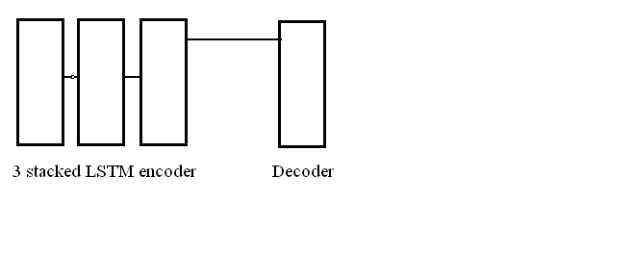
Seq to Seq LSTM Model

Slide 12
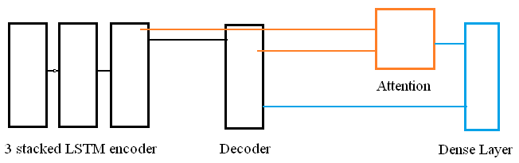
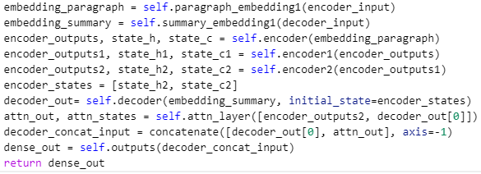
Seq to Seq LSTM Model

Slide 13
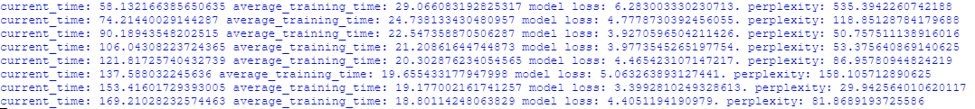
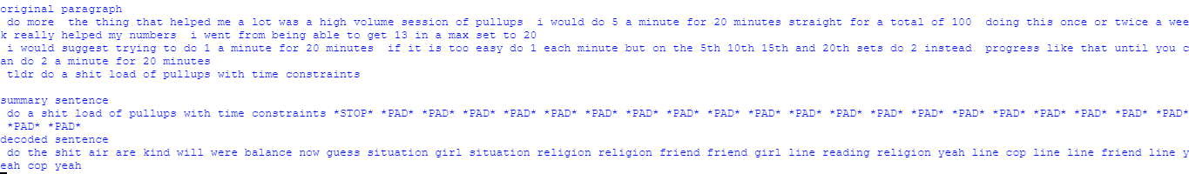
LSTM Results

Slide 14
Discussion and future directions
Individual models are able to produce text
Pipeline models and compare generated text to individual models
Beam Search
Can use beam search algorithm instead of using the random from k maximum probabilities to decode the summary
Train all models: query algorithm, summarizer algorithm, gpt-2 algorithm, simultaneously
Train for an epoch or longer

